Slide 1

MAZE SOLVER USING DFS
ENPM809Y - Introductory Robot Programming
Group 4
Karan Sutradhar, Sudharsan Balasubramani, Sai Praveen Bhamidipati, Ashwin Prabhakaran

Slide 2
INTRODUCTION
Objective :
We implemented a program that computes a path given the current position/ starting position (S) and orientation (fixed in this case) of a robot in a maze to reach the center of the maze (G).
Method :
Path Planning Algorithm is Depth First Search Algorithm (DFS)

Slide 3
CONSTRAINTS/ ASSUMPTIONS:
The Robot doesn’t know the location of the wall unless it reaches near it.
MMS Simulator interface
Selection of maze from given mazes. ( Discretized mazes)
Robot transverse in only x-y direction (2D plane)
Robot can only move in forward direction and have holonomic behavior, it cannot move in arbitrary direction.
Action space of robot is right, left and Forward.

Slide 4
LEARNING OUTCOMES
Object-oriented programming, inheritance, and dynamic polymorphism.
Implementation of Path Planning Algorithm ( DFS ) using dynamic programming.
Usage of Data Structures.

Slide 5
METHODOLOGY
OOP based programming
Simulator interface - API class
Reading maze from given set of mazes and dynamic implementation of path planning algorithm (DFS - which doesn’t give the cost effective or optimal path).

Slide 6
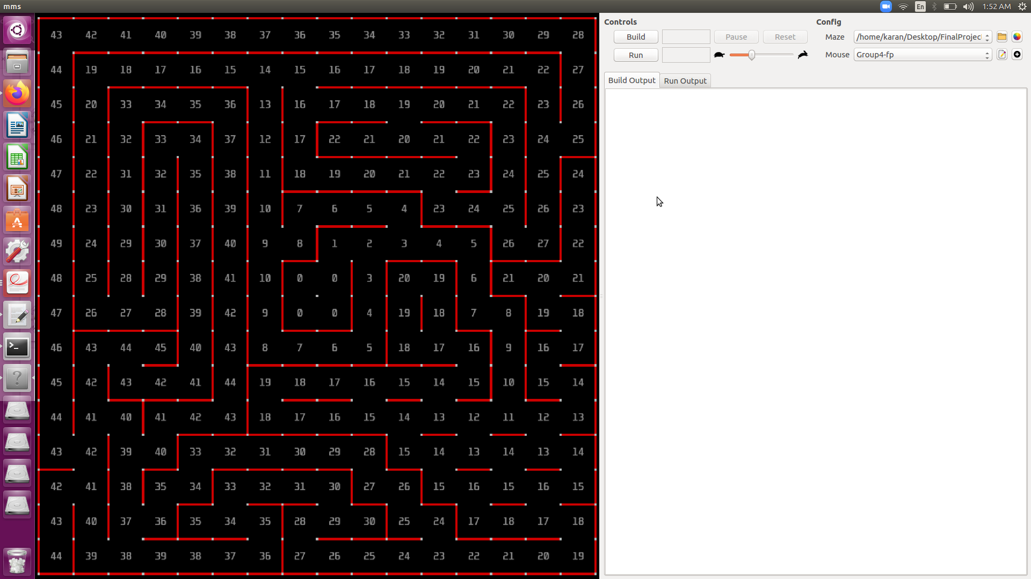
MMS Simulator

Slide 7
Class Structure
main.cpp
Algorithm
Maze
LandBased
Robot
LandBased
Wheeled
LandBased
Tracked
API

Slide 8
Node Data Structure
Struct Node {
//---> Attributes <---// std::array<int, 2> parent_node_;
//---> Default constructor <---// Node(): parent_node_{}{}
//---> Destructors <---// ~Node()= default;.
};
std::array<std::array<Node, 3>,3> node_info_;

Slide 9
Process Flow
Create a Shared_ptr for robot object
std::shared_ptr<fp::LandBasedRobot> wheeled
Create an algorithm class Object
fp::Algorithm algorithm;
Call Mazer solver and pass the robot shared_ptr object as argument to Solver()
algorithm.Solve(wheeled);
Back track path from goal to start, by passing reached goal node to Backtrack()
algorithm.BackTrack(algorithm.end_goal_, algorithm.node_master_);

Slide 10
Maze Solver Implementation
Initialize & set robot’s current node, parent node and direction &
fp::Algorithm::SetDefaults()
Robot Object as Input
While
Read & Set all the walls around the robot
fp::Maze::Readmaze()
Compute new path from current node using
fp::Algorithm::DFSAlgorithm()
True
Mark current node Visited
Path blocked ?
Yes
No
No
Is
Goal?
Yes
Update current node
No path Found!
No
Path found ?
Is
Visited ?
Yes
No
Yes
Set current node as goal & mark current node with Red color, Exit loop
Navigate the robot to the next node in the path
fp::Algorithm::Navigate()
Back track from goal to current node & update path
fp::Algorithm::BackTrack()
Update current node’s parent in Node Master

Slide 11
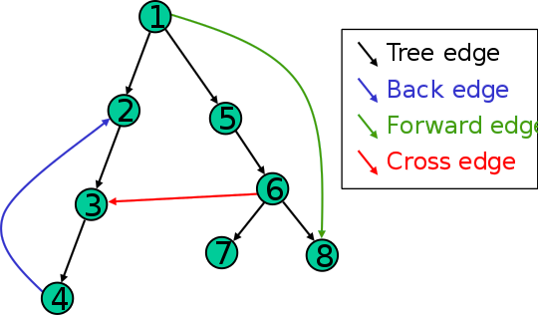
DEPTH-FIRST SEARCH
Depth-First Search (DFS) is an algorithm for traversing or searching tree or graph data structures.
The algorithm starts by selecting some arbitrary node as the root node and explores as far as possible along each branch.

Slide 12
DEPTH-FIRST SEARCH
The implementation of DFS is similar to that of BFS, but differs in two ways,
It uses stack instead of queue.
It delays checking whether a vertex has been discovered until the vertex is popped from the stack rather than making this check before adding the vertex.
After the goal is reached, it shows a path from the start node to the goal node.

Slide 13
Get Start node as Input
Add start Node to the stack
Pop the stack and set as current node
Is Goal?
True
Set current node as goal & Return True
While
(stack is not empty)
False
True
Return False
Is
Explored?
No
Find the neighbor nodes
Yes
North
South
East
West
Get Robot
Robot Current Direction
Add neighbors' nodes to the stack in the order based on robot current direction
Mark current node Explored
S - E - N - W
Yes
N
Yes
No
DFS Algorithm
Implementation
N - W - S - E
S
Yes
No
E - N - W - S
W
No
W - S - E - N
Yes
E

Slide 14
BACKTRACKING
Backtracking means that when there are no new nodes to move forward by the algorithm, it traverses back on the same node to find the path.
In order to back track, a parent node data type is introduced which matches to its respective child nodes.
Also a visited data set is used, so that to keep track of the nodes which has already been seen by the robot. This prevents from duplicating a node. Only the new nodes would be added onto the stack.
The backtracking will be done based on the cost map, whichever path is the least from the start to goal node based on the cost function, the backtracking takes place.

Slide 15
Goal Node
&
Node Array
Push goal node to path Stack & set as current_node
Get the parent node of the goal node from Node Array
Color the backtracked cell using
While
current_node != parent_ node
Exit and return Path Stack
fp::Maze::ColorPath(current_node);
Set parent node as current node
Back
Tracking
Set parent node by getting parent node of current node
Push current node to
the path stack

Slide 16
PROJECT EXECUTION
Visit this Github link https://github.com/mackorone/mms#building-from-source to install Micromouse simulator.

Slide 17
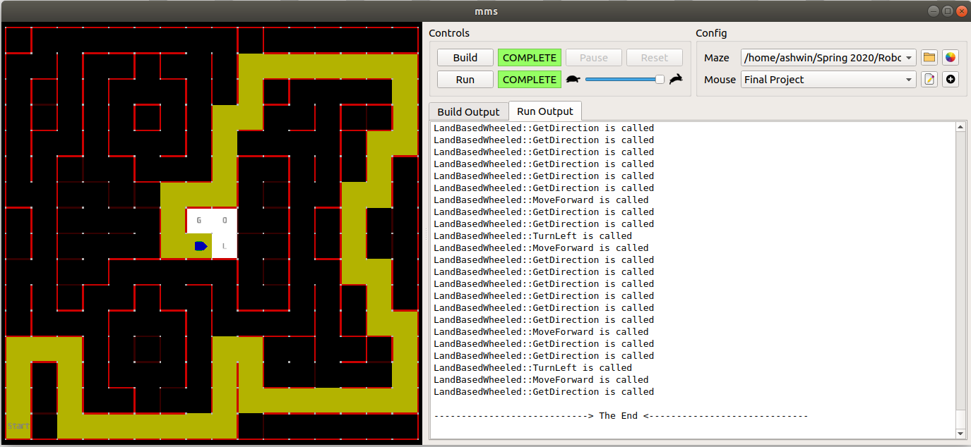
RESULTS
Successfully implemented DFS Algorithm to solve the maze.
OOP based programming.

Slide 18
FUTURE SCOPE
We would like to implement other path planning algorithms like BFS, Dijkstra, A*, etc for the same maze.
For different and difficult mazes we would like to implement a code which runs faster and give optimal results.
Changing the Micro-mouse Simulator to add dynamic obstacles on already explored locations.

Slide 19
REFERENCES
DFS Algorithm : https://www.tutorialspoint.com/data_structures_algorithms/depth_first_traversal.htm
Mms simulator : https://github.com/mackorone/mms
Object Oriented Programming : https://beginnersbook.com/2017/08/cpp-oops-concepts/

Slide 20
CONTRIBUTIONS
Karan Sutradhar - Blueprint of Project/ Work Allotment-Coordinating-Setting up meetings-Time scheduling-Project timeline/Coding-DFS/Class Structure/ Presentation.
Sudharsan - Class Structure/ POC with Professor for Doubts/Coding-DFS/ Compiling Codes/ Error Handling/ Testing/ Flow Charts/ Presentation.
Sai Praveen Bhamidipati - Documentation/ Report/ Presentation/ Coding- Maze/ Coding-API/Error Handling/ Testing/ Class structure/ Background data collection.
Ashwin Prabhakaran - Documentation/ Report/ Presentation/ Coding- Maze/ Coding-API/Error Handling/ Testing/Github Maintenance/ Doxygen File/ Naming Conventions.

Slide 21
MMS Simulator Installation
Visit this Github link https://github.com/mackorone/mms#building-from-source to install Micromouse simulator.

Slide 22
Project Execution
Open the mms Simulator
Load the desired maze file
Config the source file and executables
Enter Build Command
Enter the path to the project directory
Click on the + button and Enter the name of the Project
Enter the run command
Click Build Button
Upon Successful Build, Click Run Button

Slide 23
THANK YOU
ANY QUESTIONS?

